Slide 1
21AIE213 BIG DATA ANALYTICS
End Semester Project Presentation

Slide 2
Team Memebers
Bhaswanth Reddy – CB.EN.U4AIE21106
Abhinav.V – CB.EN.U4AIE21177
Karthik MS- – CB.EN.U4AIE21121
Sai Praneeth Reddy A - – CB.EN.U4AIE21103

Slide 3
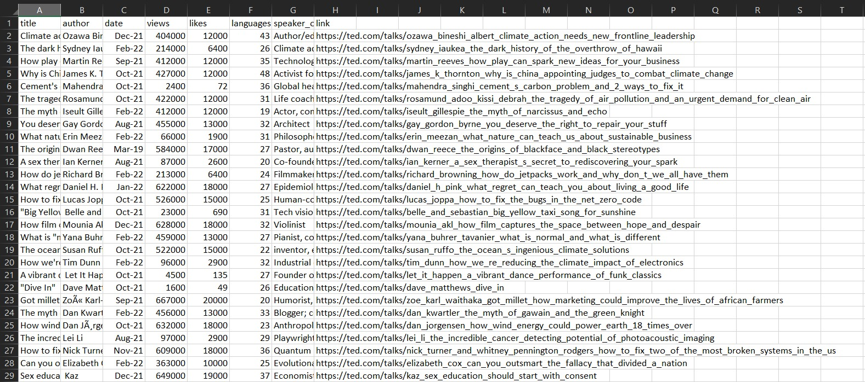
Dataset – TedEX Talk Dataset

Slide 4
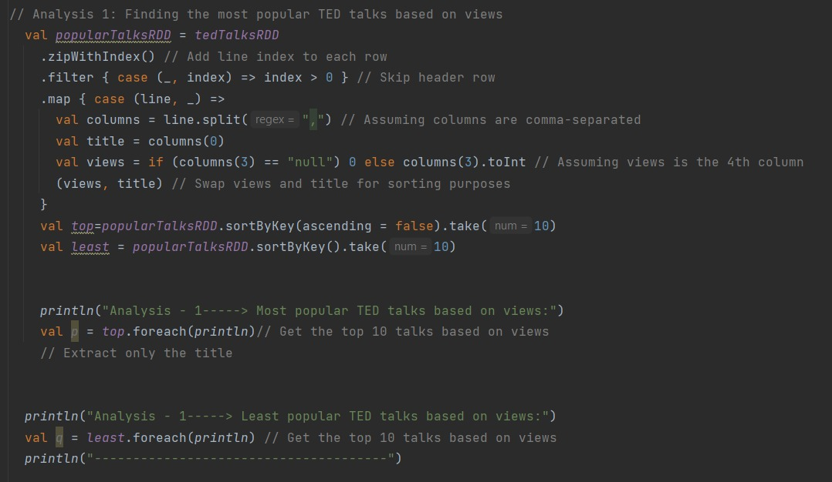
Analysis-1:
Finding the most popular TED talks based on views

Slide 5
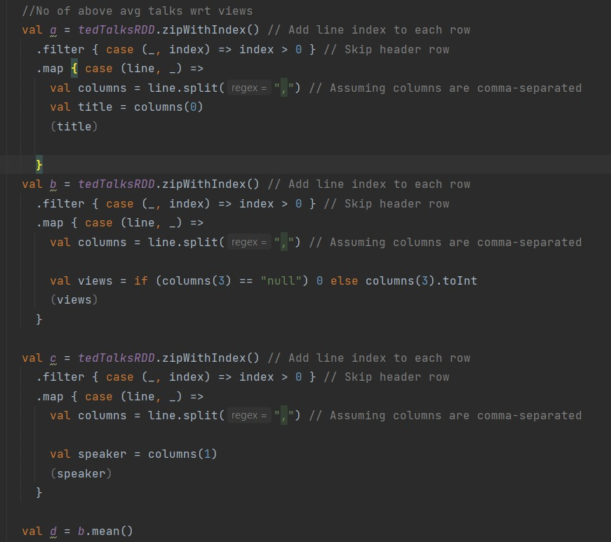
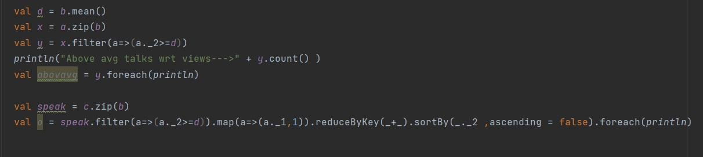

Slide 6
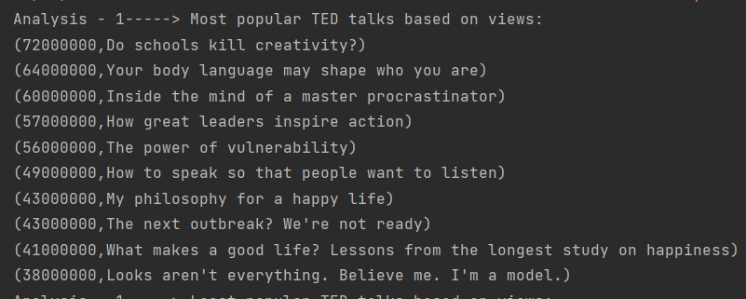
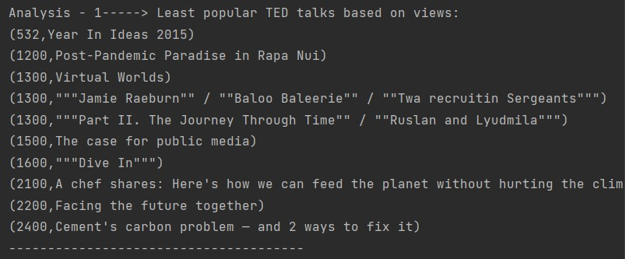
Output:
This analysis aims to identify the most popular and least popular TED talks based on the number of views they have received.
The tedTalksRDD (TED Talks dataset) is processed to extract the title and views for each talk.
The RDD is transformed by mapping each talk's views and title, and the views are swapped with the titles for sorting purposes.

Slide 7
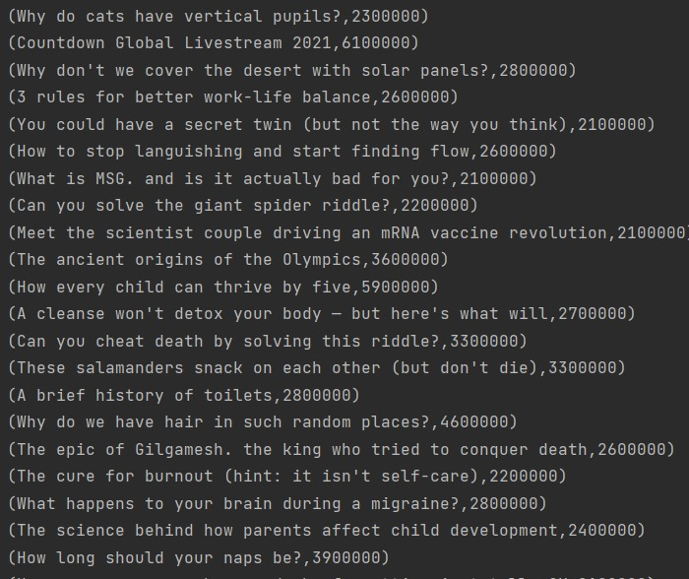
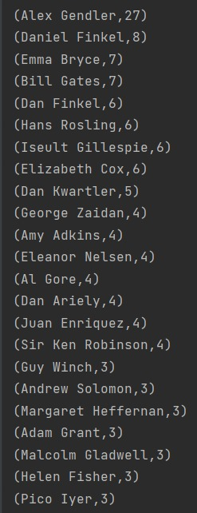
We have sorted out the above avg ted talks based on views.
We have found the top authors based on views and the no of times they presented.

Slide 8
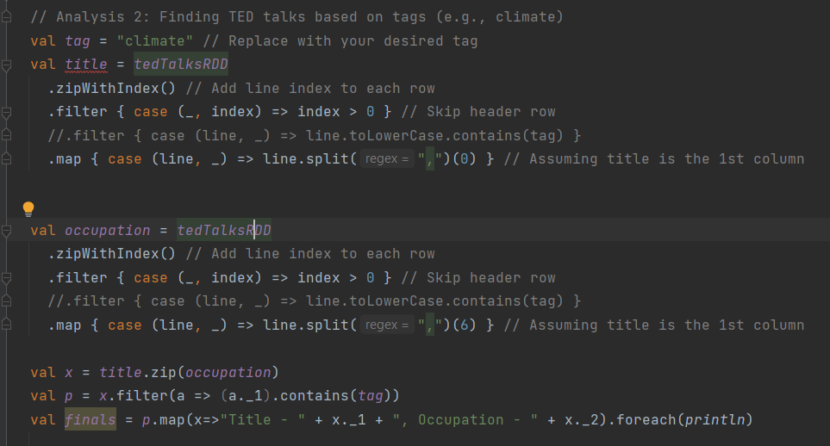
Analysis-2: Ted talk based on tag

Slide 9
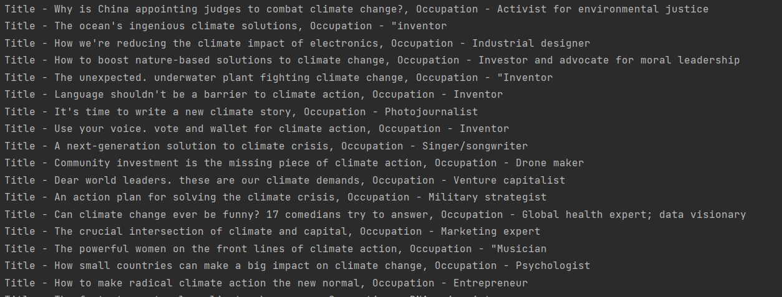
Output

Slide 10
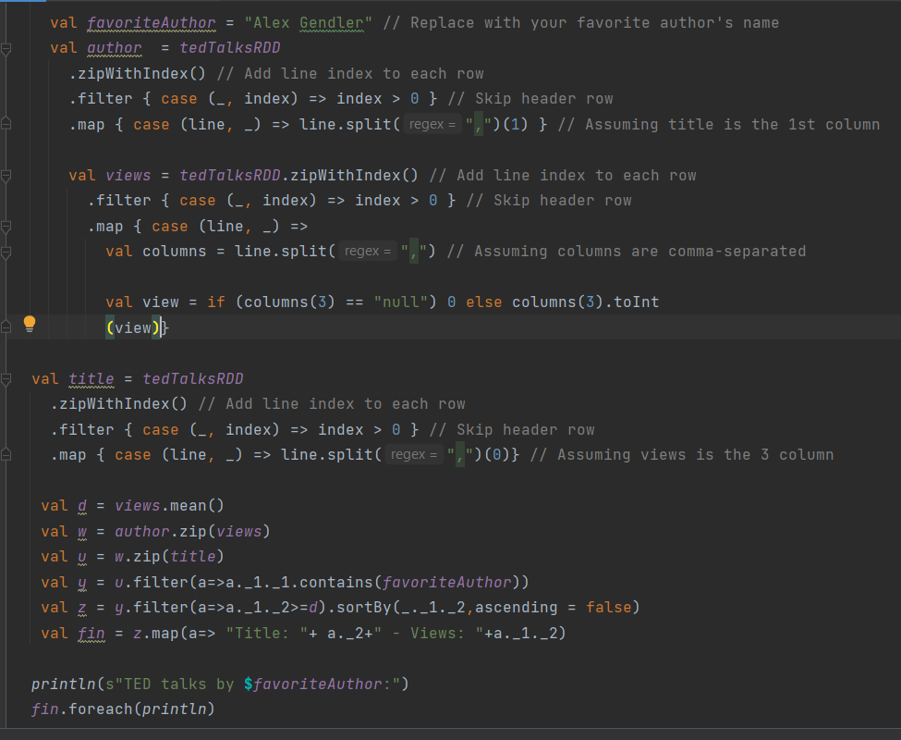
Analysis-3:Finding TED talks based Favourite author

Slide 11
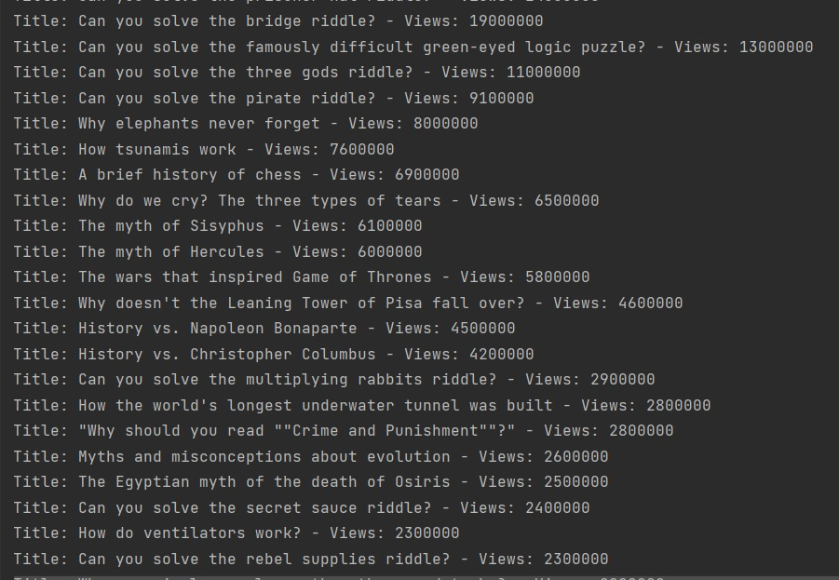
Output:

Slide 12
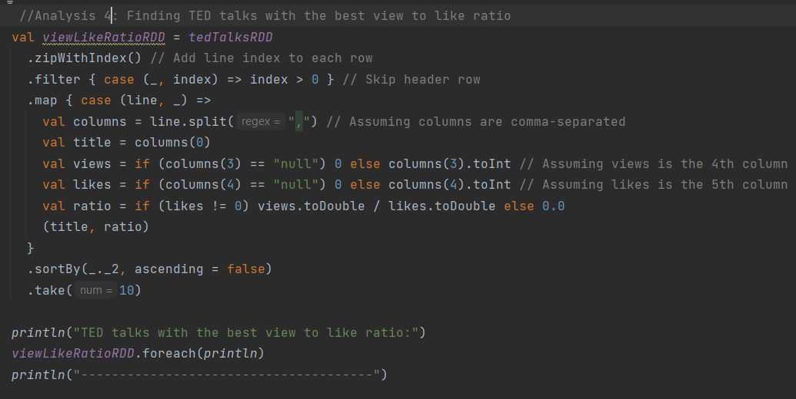
Analysis-4: Talks with best view to like ratio

Slide 13
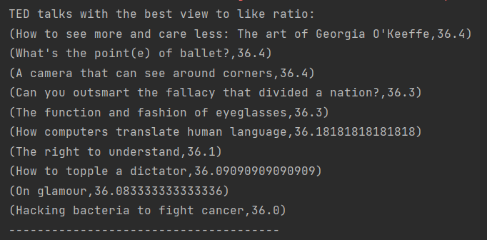
Output:

Slide 14
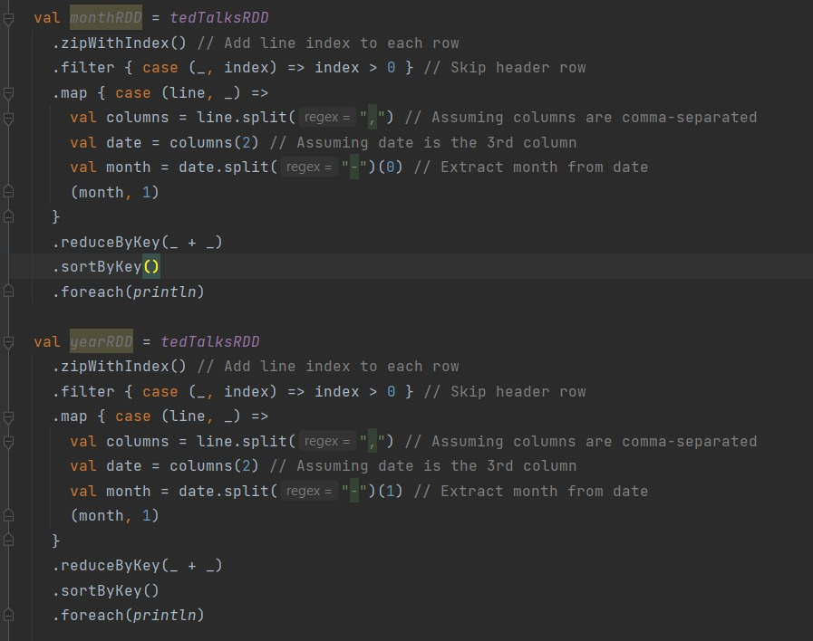
Analysis-5: Month and year wise analysis

Slide 15
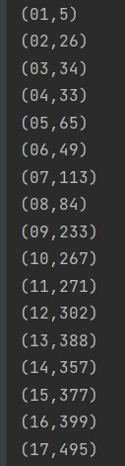
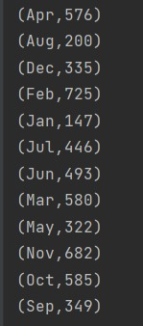
Yearly Analysis
Monthly Analysis
Output

Slide 16
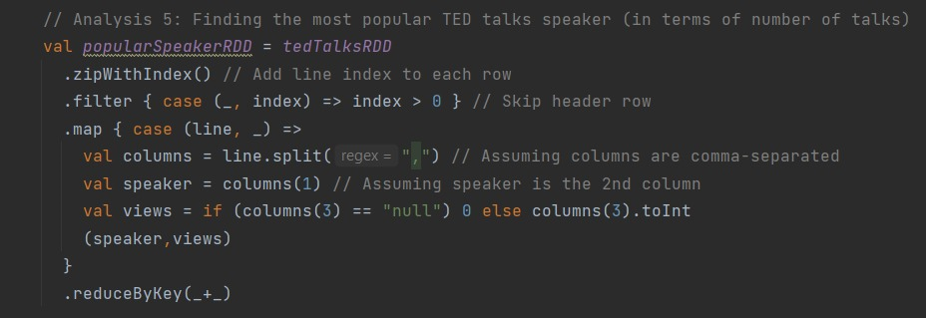
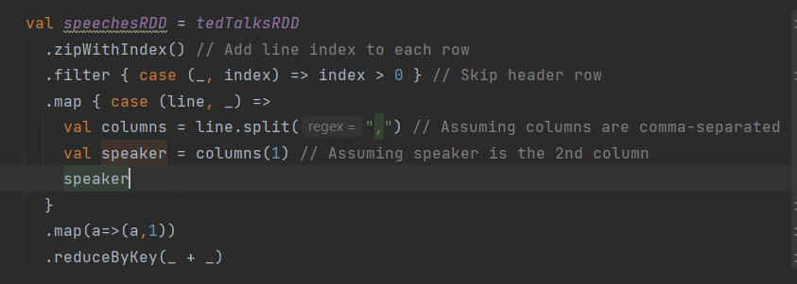
Analysis-6: Finding the most popular TED talks speaker (in terms of number of talks)

Slide 17
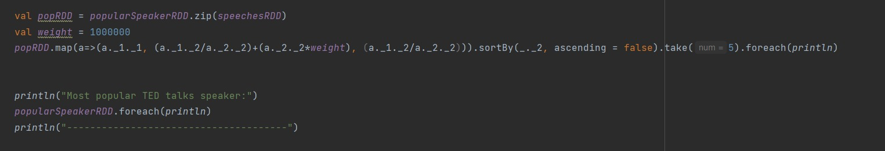
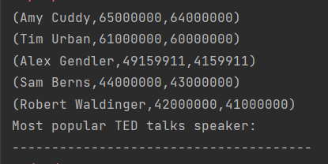
Output

Slide 18
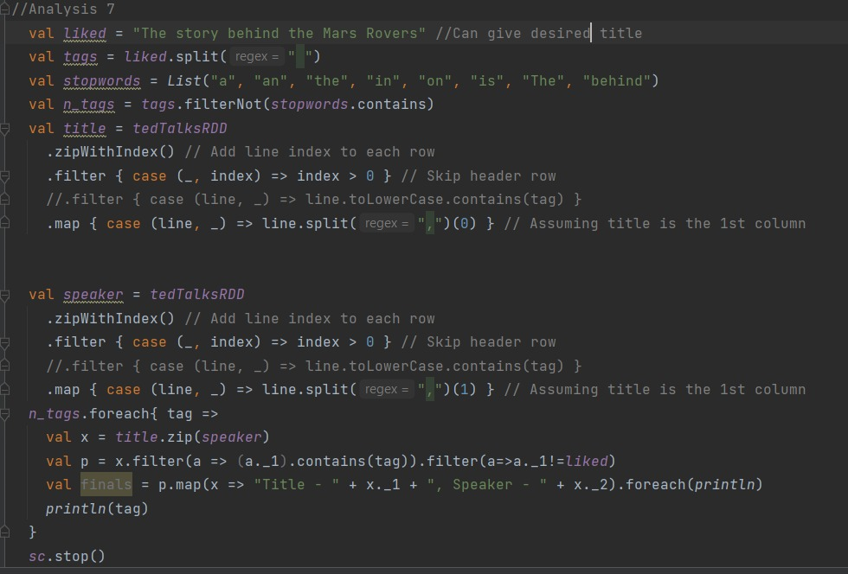
Analysis-7: Finding TED talks based on given random title

Slide 19
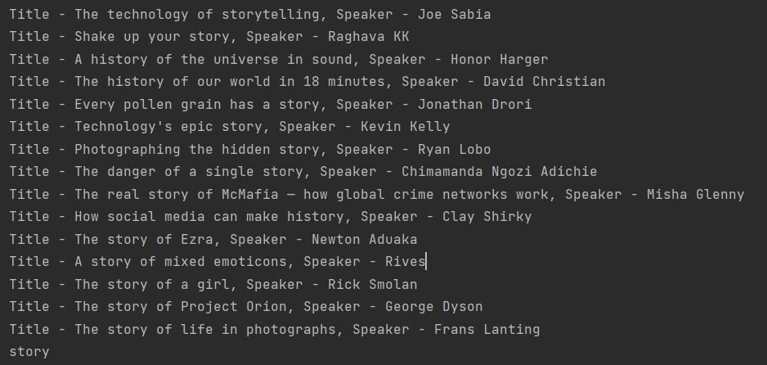
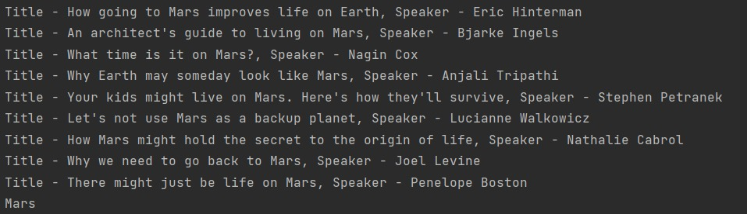
Output:

Slide 20
Thank you

